Slide 1
Information and Communication Technologies presentation
Here our presentation begins

Slide 2

In this representation we will see
Introduction
Website (work , daily activities ….)
Communication (social media)
Technologies related to tic (git , github …)
The impact of Information and Communication Technologies
Technology evolves over time
conclusion

Slide 3
introduction
ICT or Information and Communication Technologies is the infrastructure and components that enable modern computing. Among the goals of IC technologies, tools and systems is to improve the way humans create
Information Technology
Digital Media
Communication
Software Applications
Internet Technologies
Hardware Devices

Slide 4



website
Influential sites
Explore how TIC is utilized in the context of website development.

Slide 5





We have a multiple of website that we use in our life in different area

Slide 6
example Websites
01
02
03
Content Management Systems
E-commerce
Design
04
05
06
Development Technologies
Trends and Innovations
Web Security
Platforms that simplify the creation and management of digital content
technologies that support the creation and management of online stores
You can describe the topic of the section here
HTML, CSS, and JavaScript language programming
Trends shaping the future of web development
Measures to secure data transmission and build trust with users.

Slide 7
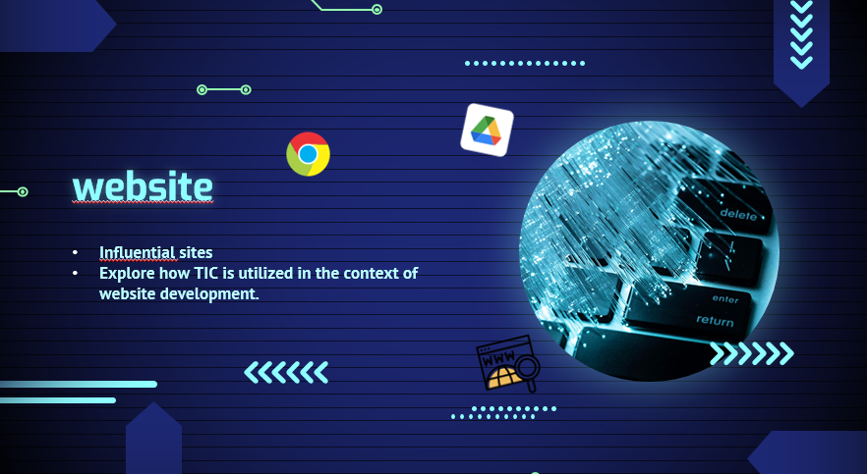
Management Systems
Explore how TIC is utilized in the context of website development
LAST SLIDE
Development Tools and Frameworks
Used app :
Html,css,java
Frameworks
C,C++ and other programming web
Control Systems

Slide 8
In this representation we will see
Introduction
Website
Communication (social media)
Technologies related to tic
The impact of Information and Communication Technologies
Technology evolves over time
conclusion
ICT plays a pivotal role in shaping how individuals, businesses, and societies communicate

Slide 9
Percentage of population connected to the Internet
67%
Connected to the Internet
Nearly 5 billion people use social networking sites
32%
disconnected
2.6 billion people doesnt

Slide 10



Some examples of the population that uses Tic to communicate
250M
700M
2B
discord
instagram
G-mail
Tic simplify communication and It makes the world a small village due to the speed of communication and the speed of news circulation

Slide 11
04
Technologies related to tic
git , github , microsoft , google services

Slide 12
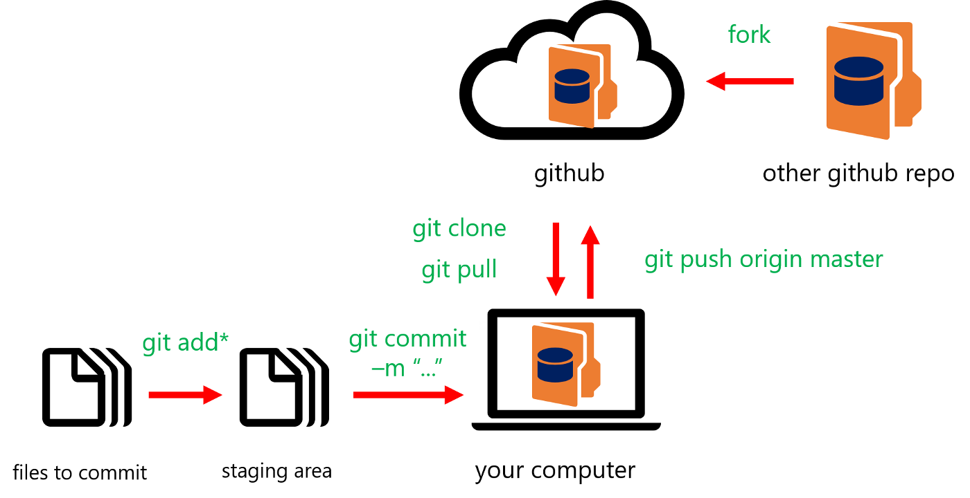

Git github
GitHub is a web-based platform for version control and collaborative software development using Git
definition
Partner 1
Partner 2
The Sun is the star at the center of the Solar System
Earth is the third planet from the Sun and where we live
example
Partner 4
Venus is the second planet from the Sun. It’s hot there

Slide 13





Microsoft submissions
One of the most influential sites that we use to : Project presentation. Submission CV
exel
word
oneNote
powerpoint
outlook

Slide 14
05
The impact
Results and development of science

Slide 15






have revolutionized global connectivity, transforming communication, business, education, and healthcare while shaping modern economies and societies.
Digital commerce and transactions
Save time, effort and money
Facilitating study and its resources
Facilitating financial exchanges and trade
Facilitating scientific research
New sites to make money (trading)

Slide 16
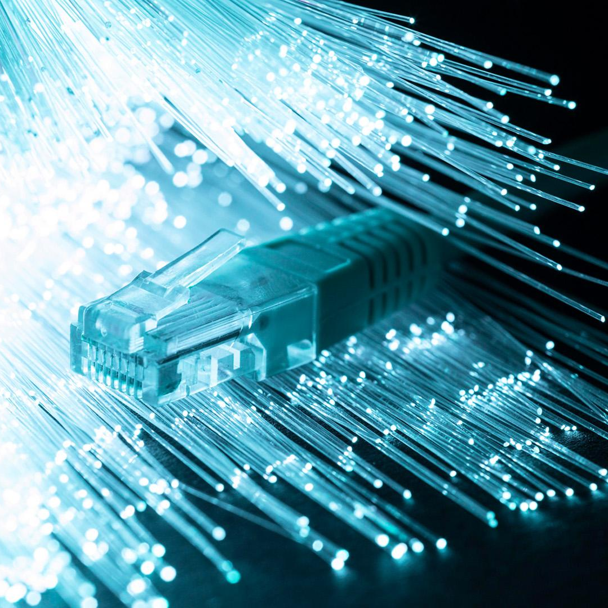
CONCLUSIONS
The ICT presentation underscores their transformative impact, revolutionizing global connectivity and shaping modern societies across diverse sectors:
ICT emerges as a pivotal force
driving innovation and efficiency in communication
business, education, and healthcare ……

Slide 17
OUR TEAM
Hamroun Sami Abdelmalek
Baatout Mohamed Amine
Rouabah Dalila Chaima
Soualah Mohammed Saber
Boumediene Noufel

